Slide 1
INFECTIOUS DISEASES
HIV/AIDS

Slide 2
HIV/AIDS
HIV stands for Human Immunodeficiency Virus
AIDS stands for Acquired Immunodeficiency Syndrome
HIV/AIDS makes up the deadliest pandemic that humankind has ever experienced. By the end of 2016 it had spread worldwide and killed more than 36 million people.
HIV/AIDS has created terror across continents and brought with it a stigma that has still not been overcome.

Slide 3
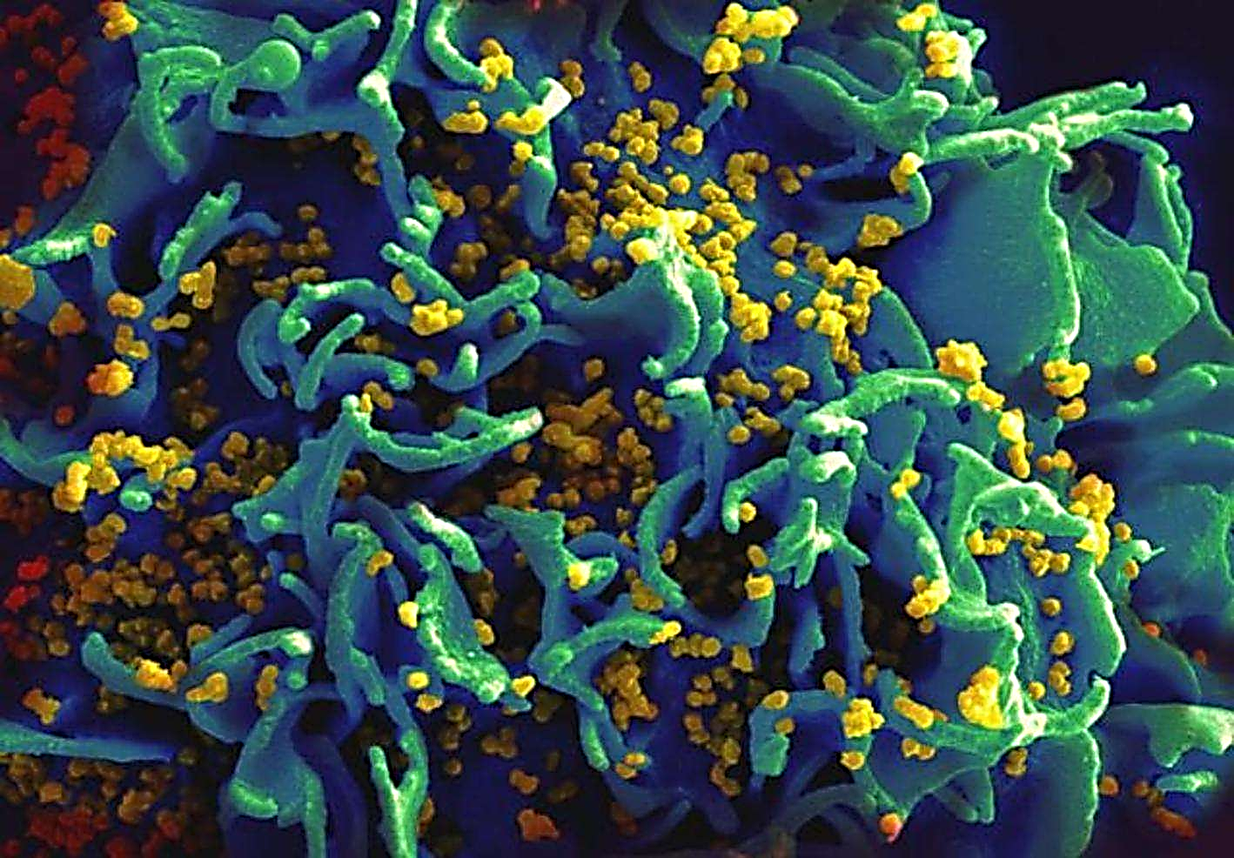

Slide 4
HIV/AIDS- Origins
It is thought to have its origins in West Africa, where the pathogen spilled over from primates to humans in the early 20th century.
By the 1960s, about 2000 people in Africa may have been infected. The earliest know case in a human being was found in a blood sample taken in 1959 from a man in the Congo. By 1980 it had spread throughout Africa and to North America, South America, Europe, and Australia

Slide 5
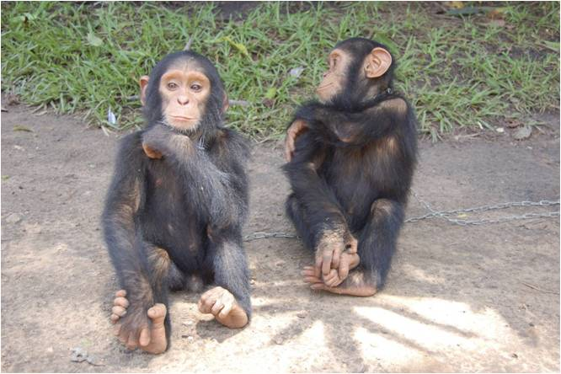
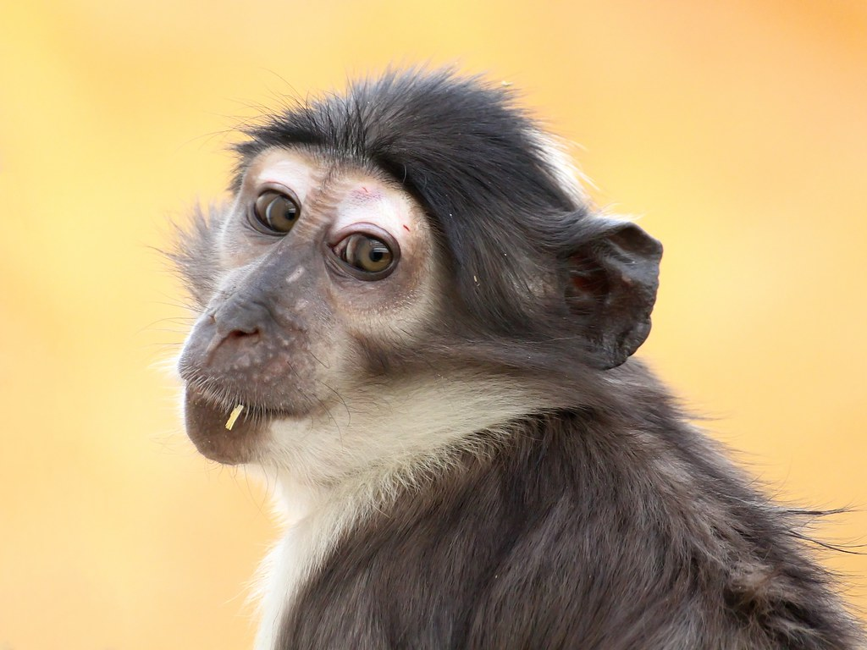
Zoonotic Spillover
HIV-1 spilled over from chimpanzees (Pantroglodytes troglodytes)
HIV-2 spilled over from sooty mangabeys (Cercocebus atys)

Slide 6
HIV/AIDS- America
The first recorded case of AIDS was on the 5th June 1981.
HIV was discovered as the cause of AIDS in 1983.
The CDC reported of an unusual infection affecting the immune system in five young, previously healthy, gay men in Los Angeles. Within days other doctors were reporting similar cases, with the only common link being that they were all gay men.

Slide 7
HIV/AIDS- America
By the end of 1981, 270 cases of the severe immune deficiency had been reported, with 121 of them already dead.
In 1982, the CDC coined the term AIDS.
Cases continued emerging amongst the homeless, marginalised, partners of those affected, drug users, haemophiliacs, Haitians, though the majority reported were homosexual men

Slide 8
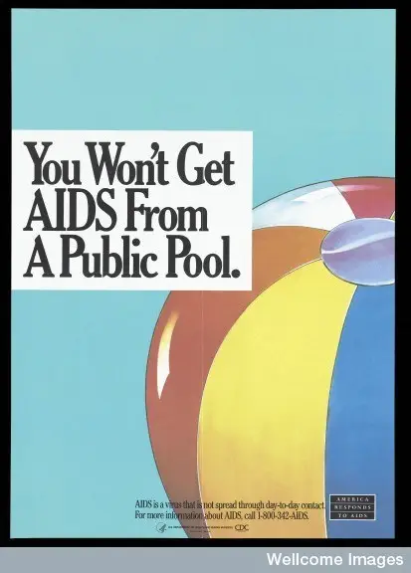
America Responds to AIDS advertising campaign,
1980

Slide 9
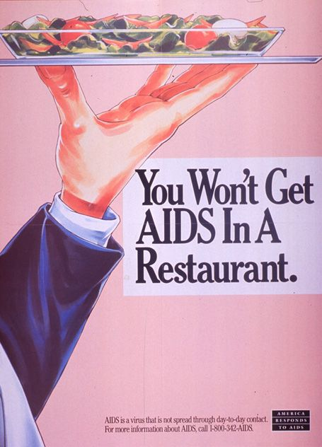
America Responds to AIDS advertising campaign,
1980

Slide 10
HIV/AIDS- America
Haitians living in the US and people living in Haiti diagnosed with AIDS in 1982 didn’t fall into one of the at-risk groups, so they were singled out as a distinct group of their own.
It was later confirmed that Haitians were no more at risk than any one else. But the damage had been done by that point. Discrimination and damage to the economy was terrible and continued to be for a long time.

Slide 11
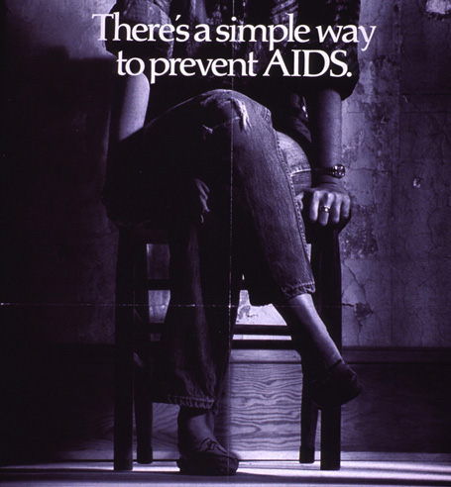
America Responds to AIDS advertising campaign,
1980

Slide 12
The Gay Plague
The apparent link between AIDS and homosexual men led it being dubbed by the media as ‘the gay plague’.
This re-ignited outdated ideas about sexuality and morality with many people claiming AIDS was God’s punishment. Patients were seen as shameful and ‘untouchable’.
People lost their jobs and Doctors warned this would reduce the amount of people coming forward to be tested, increasing the risk of spread

Slide 13

America Responds to AIDS advertising campaign,
1980

Slide 14
HIV/AIDS- America
In 1987 the USA began testing everyone who applied for a VISA and those who were found positive for the disease were banned from entering the country.
In 1983, the CDC announced that AIDS was not spread by casual contact, food, water, air nor by contact with surfaces in the environment.

Slide 15
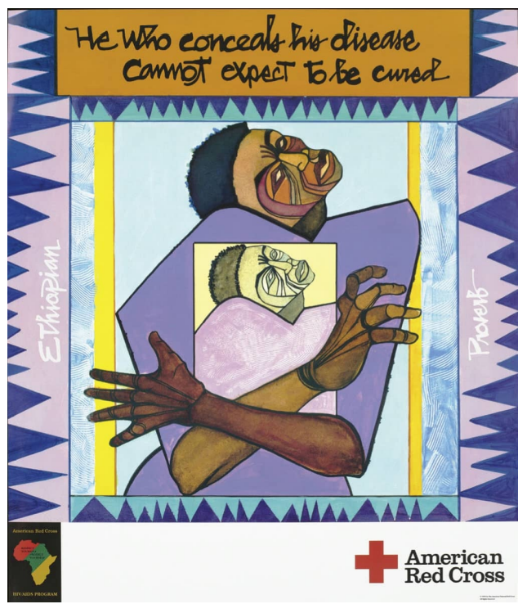
Red Cross poster
1992

Slide 16
HIV/AIDS- Locations
Starting in Africa, it spread worldwide within years
It is now found everywhere in the world
Africa still represents roughly 2/3 of all cases.

Slide 17
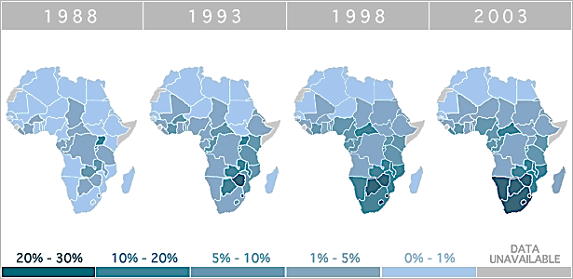

Slide 18
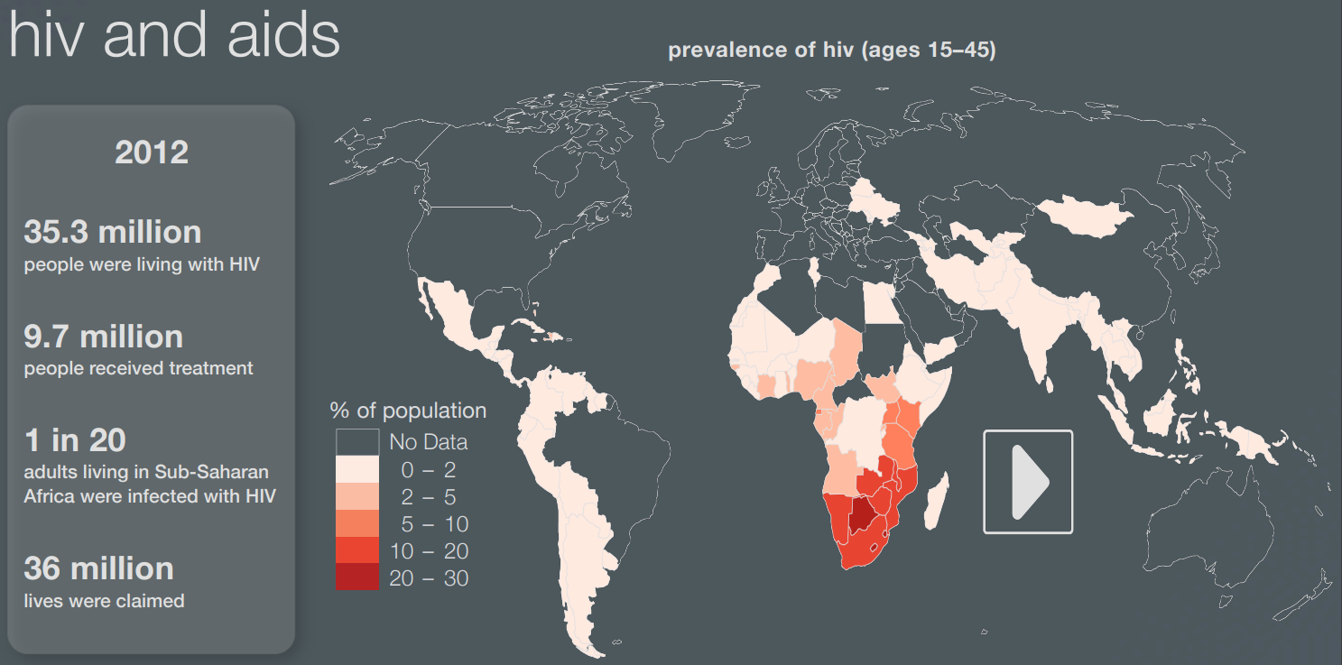

Slide 19
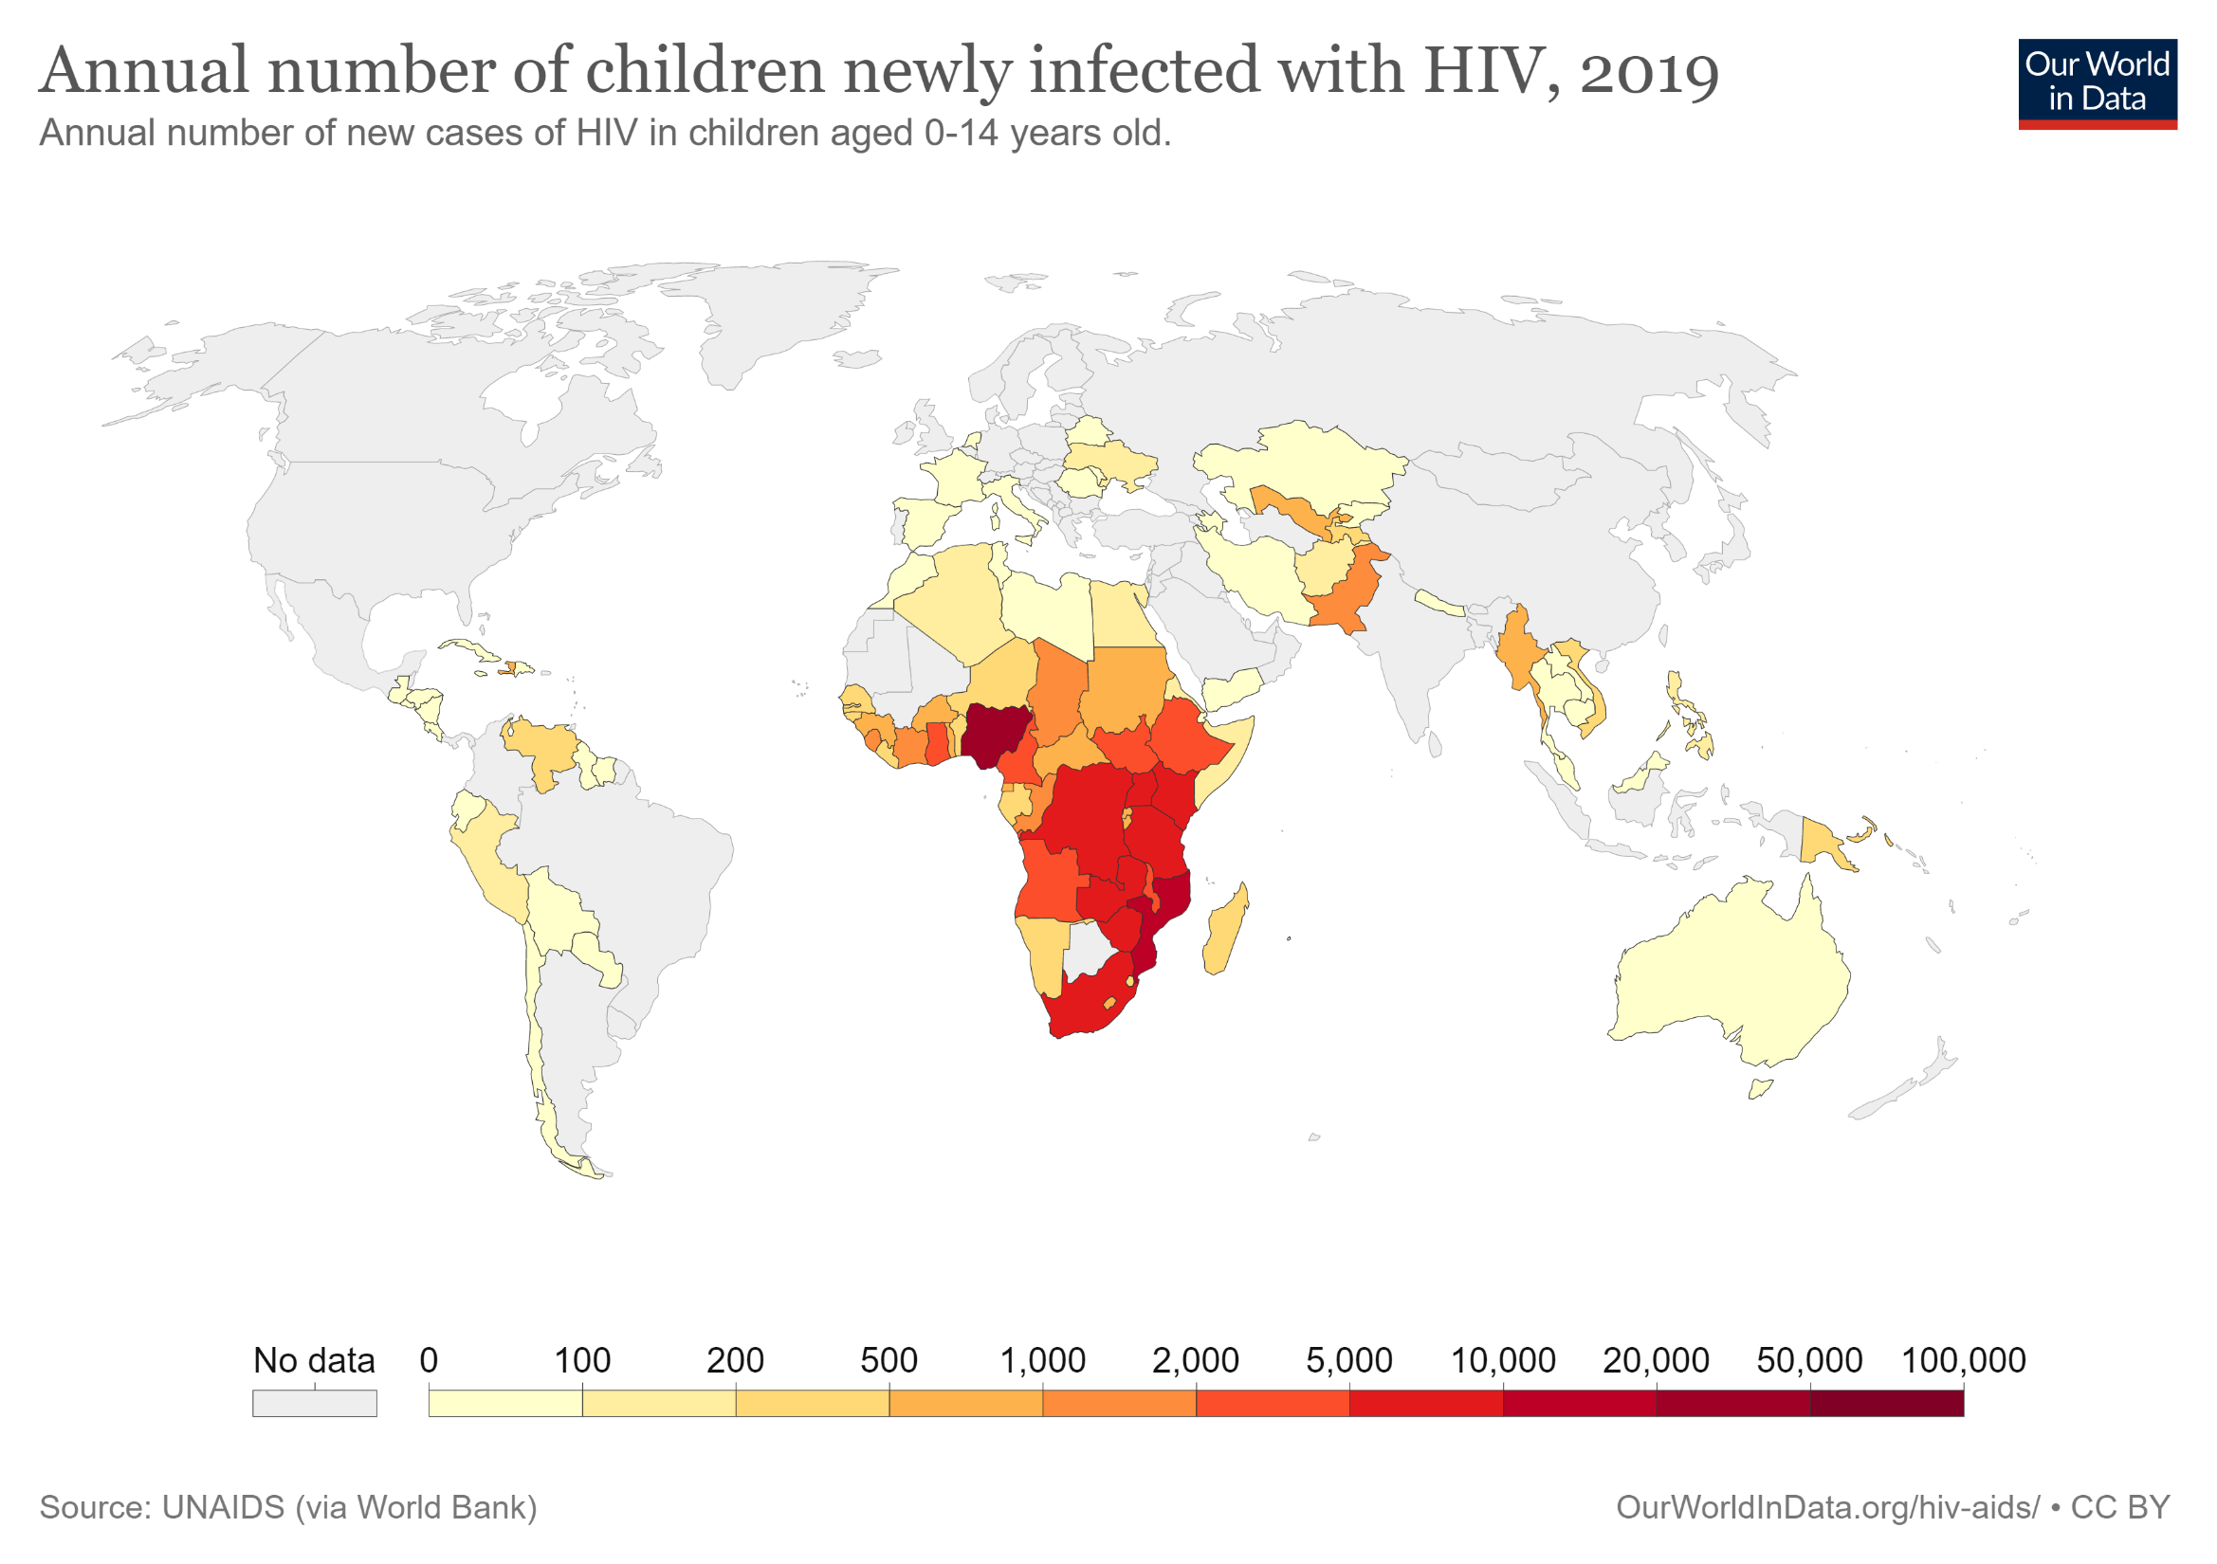

Slide 20
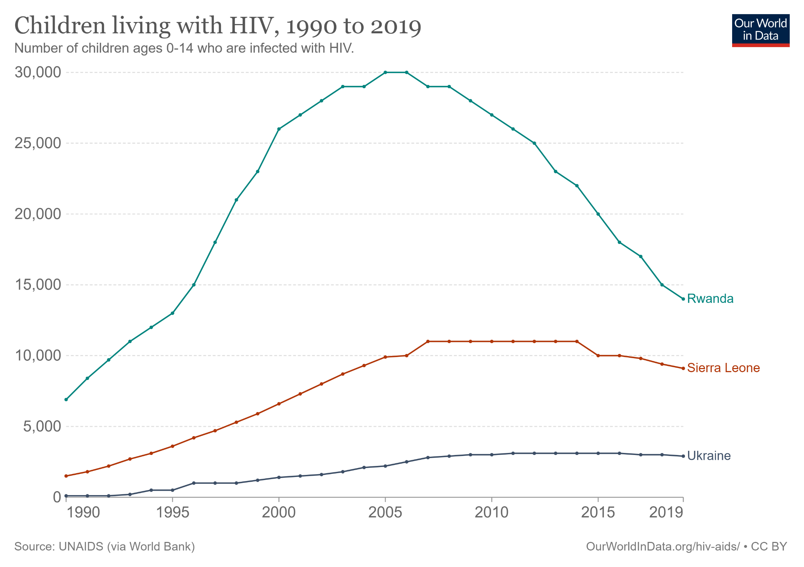

Slide 21
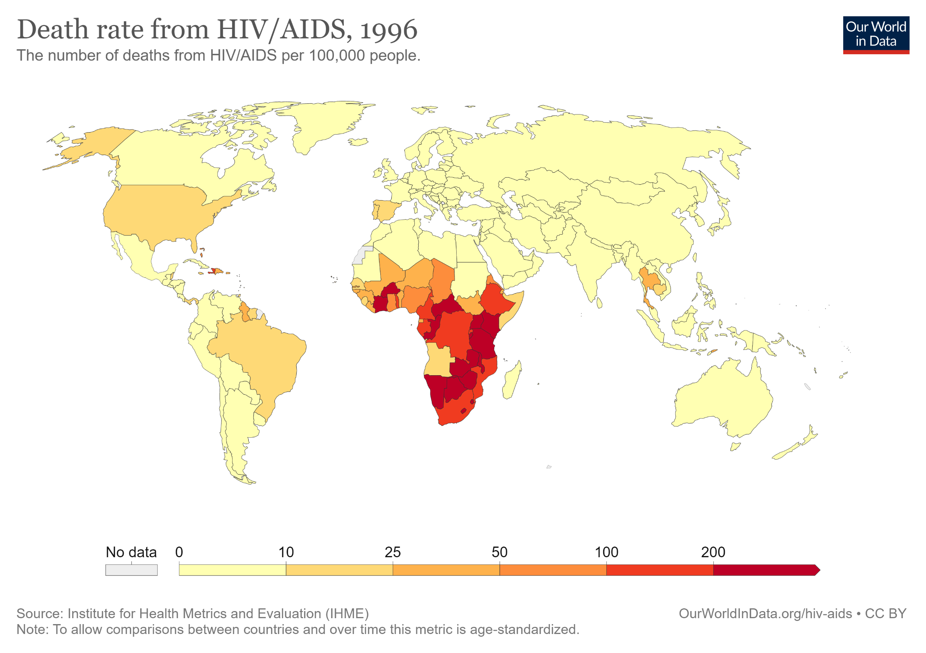

Slide 22
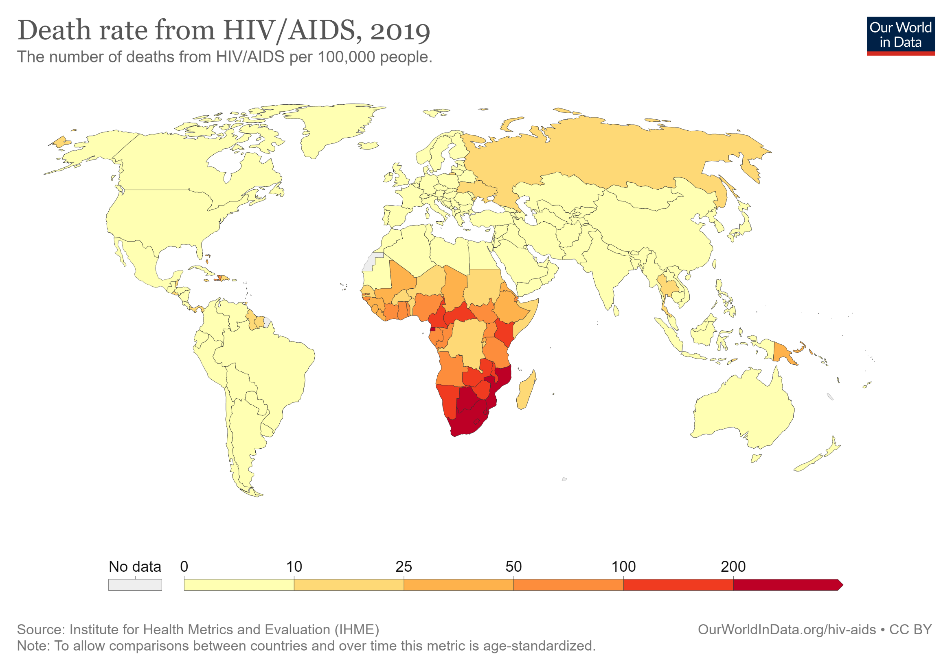

Slide 23
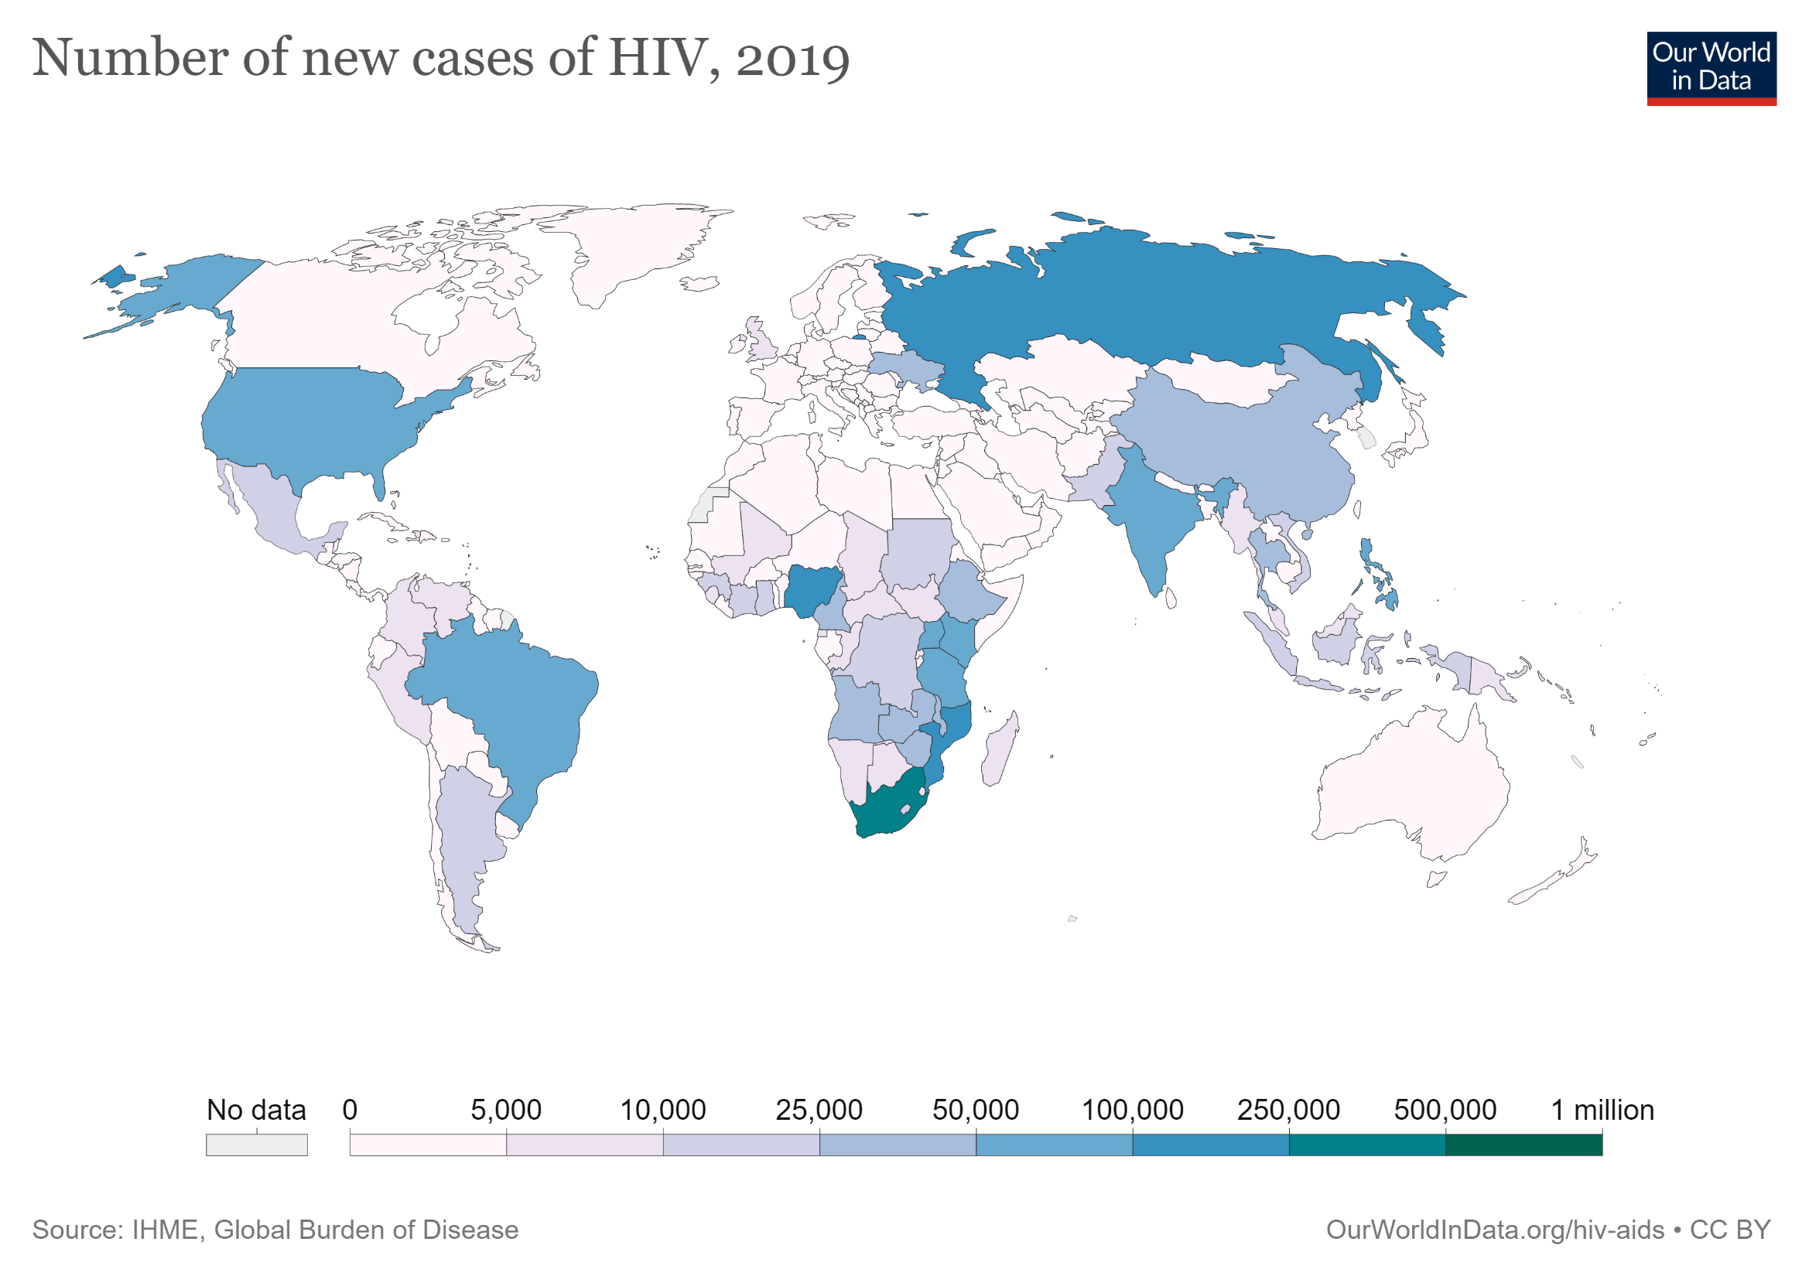

Slide 24
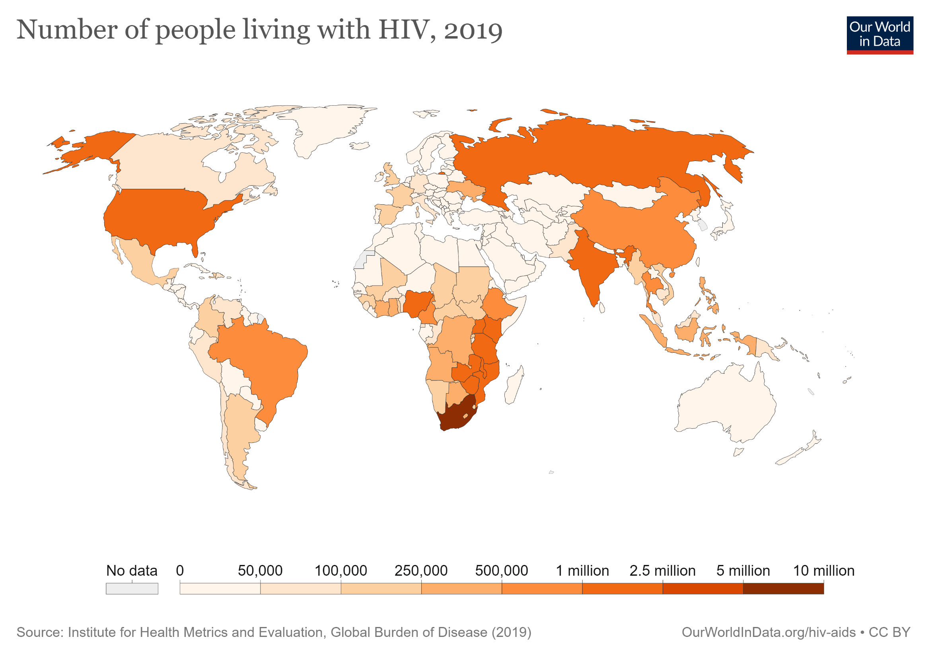

Slide 25
HIV/AIDS- Signs and Symptoms
The symptoms of HIV vary depending on the stage of infection. Though people living with HIV tend to be most infectious in the first few months after being infected, many are unaware of their status until the later stages.
In the first few weeks after initial infection people may experience no symptoms or an influenza-like illness including fever, headache, rash or sore throat.

Slide 26
HIV/AIDS- Signs and Symptoms
As the infection progressively weakens the immune system, they can develop other signs and symptoms, such as swollen lymph nodes, weight loss, fever, diarrhoea and cough.
Without treatment, they could also develop severe illnesses such as tuberculosis (TB), cryptococcal meningitis, severe bacterial infections, and cancers such as lymphomas and Kaposi's sarcoma.

Slide 27
HIV/AIDS- Fatality Rate
AIDS was a death sentence in the 1980s and 1990s
In 2020 the fatality rate was approximately 1.8%

Slide 28
The cost of treatment
All have been converted to Aus Dollars
America: $1,800 to $4,500 each month (depending on health insurance)
Australia: $890 a month
England: $581 a month
Thailand: $504 a month
Africa: $1250 a month

Slide 29
HIV/AIDS- Spread
The HIV virus can be transmitted by sex, blood products, or from an infected pregnant woman to her infant.

Slide 30
HIV/AIDS- Risk Factors
Having unprotected anal or vaginal sex;
Having another sexually transmitted infection (STI) such as syphilis, herpes, chlamydia, gonorrhoea and bacterial vaginosis;
Sharing contaminated needles, syringes and other injecting equipment and drug solutions when injecting drugs;
Receiving unsafe injections, blood transfusions and tissue transplantation, and medical procedures that involve unsterile cutting or piercing; and
Experiencing accidental needle stick injuries, including among health workers

Slide 31
HIV/AIDS- Diagnosis
HIV can be diagnosed through rapid diagnostic tests that provide same-day results. People can also use HIV self-tests to test themselves. However, no single test can provide a full HIV diagnosis; confirmatory testing is required, conducted by a qualified and trained health or community worker at a community centre or clinic.
Most widely-used HIV diagnostic tests detect antibodies produced by the person as part of their immune response to fight HIV. In most cases, people develop antibodies to HIV within 28 days of infection.

Slide 32
HIV/AIDS- Treatment
HIV disease can be managed by treatment regimens composed of a combination of three or more antiretroviral (ARV) drugs.
Current antiretroviral therapy (ART) does not cure HIV infection but highly suppresses viral replication within a person's body and allows an individual's immune system recovery to strengthen and regain the capacity to fight off opportunistic infections and some cancers.

Slide 33
Celebrities and representation
https://www.youtube.com/watch?v=R5eEQJZm7ZM
The Last Song, by Elton John
The song tells of an estranged father coming to terms with the sexuality of his gay son, who is dying of an AIDS-related illness and was the first of Elton's American singles to benefit his AIDs foundation. It was composed by Elton with lyrics provided by Bernie Taupin who faxed the lyrics to him in Paris, shortly after Queen lead singer Freddie Mercury had died. 'I was crying all the time as I wrote the music', John told The Advocate, 'and it was very hard for me to sing it.‘
The Elton John AIDS Foundation has raised over $515 million since 1992.

Slide 34
Celebrities and representation
Freddie Mercury Tribute Concert
https://www.youtube.com/watch?v=ANQspcmfhJU
In the 21 years since it started, the Mercury Phoenix Trust has raised $15 million for HIV/AIDS medication, treatment and research
Whilst Freddie kept his diagnosis a secret until the day before his death, Freddie spent the years previous volunteering to trial different treatments and donating large sums to ensure treatment for as many people as possible.

Slide 35
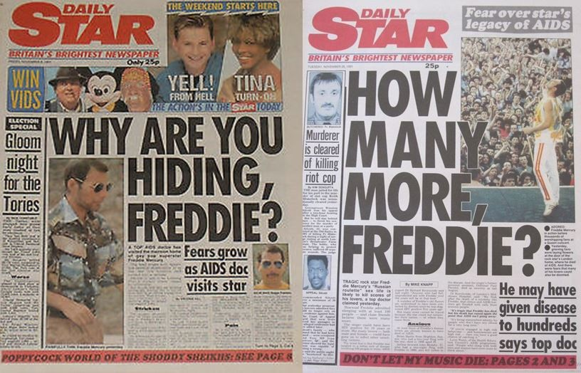
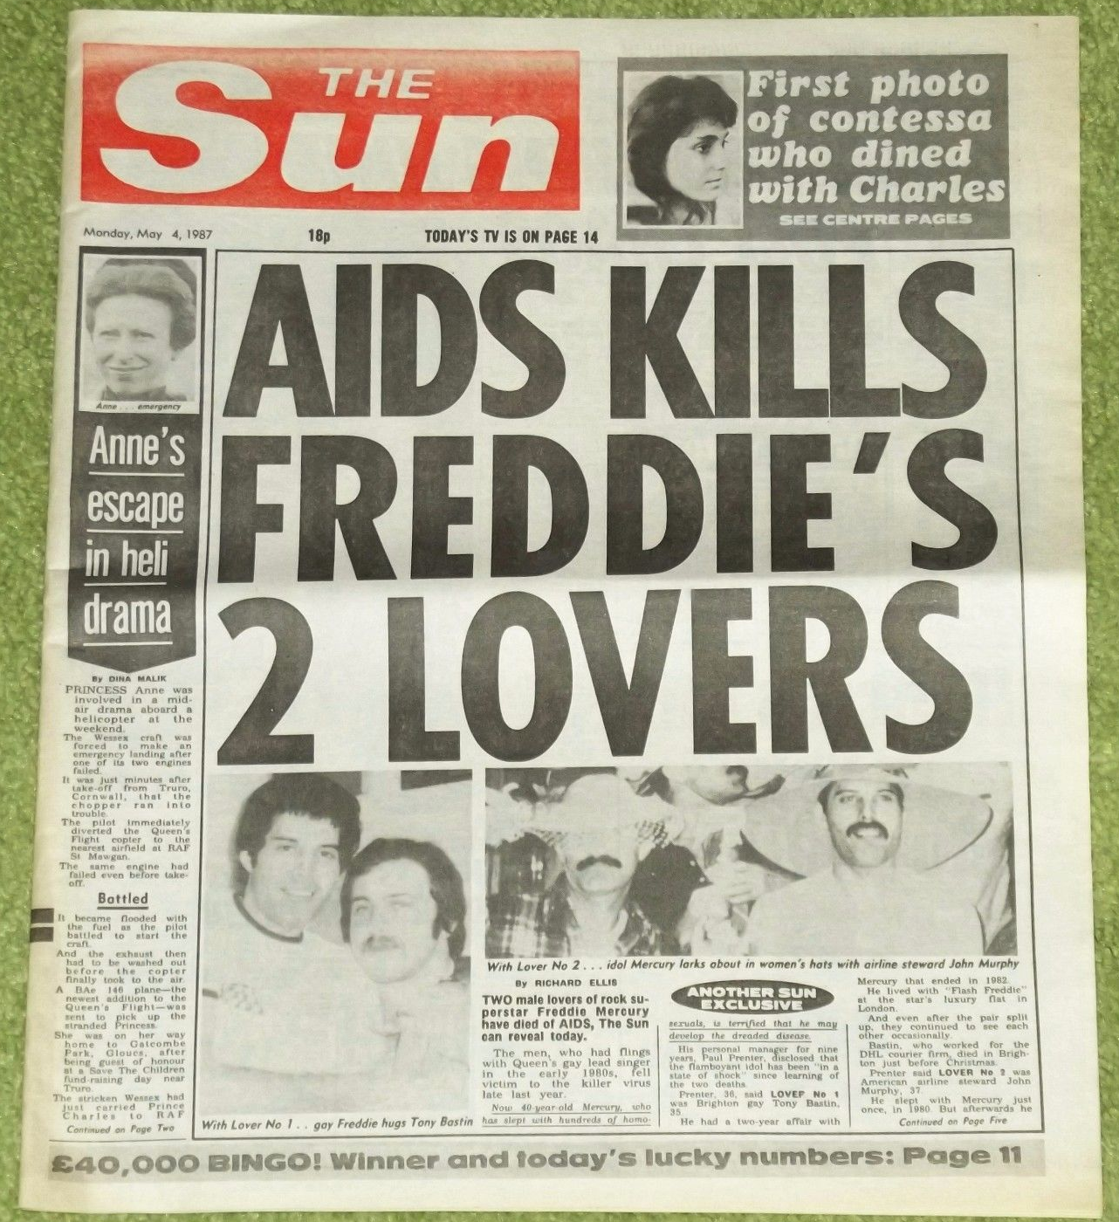

Slide 36
Celebrities and representation
Annie Lennox
https://www.youtube.com/watch?v=LRIm5ufzMd4
Dedicates much of her time to raising awareness of the HIV/AIDS pandemic in Africa.
Lennox released a special fundraising single called Sing, which featured a 23-member choir of female celebrities, including Madonna, Faith Hill, Pink, and many more. Proceeds from the single went to the Treatment Action Campaign (TAC), an organization that that provides much needed support in the continent’s struggle against the deadly virus.
“One third of pregnant women in South Africa are HIV positive,” Lennox told CNN. “We can prevent their children being born with the virus if we let the women have access to treatment. If you do not allow that to happen, you’re going to have future generations simply being wiped out.”

Slide 37
HIV/AIDS going forward
February 2022
An American research team reported that it has possibly cured HIV in a woman for the first time. Building on past successes, as well as failures, in the HIV-cure research field, these scientists used a cutting-edge stem cell transplant method that they expect will expand the pool of people who could receive similar treatment to several dozen annually. Researchers also know of two women whose own immune systems have, quite extraordinarily, apparently vanquished the virus.
In the first case of what was ultimately deemed a successful HIV cure, investigators treated the American Timothy Ray Brown for acute myeloid leukaemia, or AML. He received a stem cell transplant from a donor who had a rare genetic abnormality that grants the immune cells that HIV targets natural resistance to the virus. The strategy in Brown’s case, which was first made public in 2008, has since apparently cured HIV in two other people. But it has also failed in a string of others. This therapeutic process is meant to replace an individual’s immune system with another person’s, treating their cancer while also curing their HIV. First, physicians must destroy the original immune system with chemotherapy and sometimes irradiation. The hope is that this also destroys as many immune cells as possible that still quietly harbor HIV despite effective antiretroviral treatment. Then, provided the transplanted HIV-resistant stem cells engraft properly, new viral copies that might emerge from any remaining infected cells will be unable to infect any other immune cells.
It is unethical, experts stress, to attempt an HIV cure through a stem cell transplant — a toxic, sometimes fatal procedure — in anyone who does not have a potentially fatal cancer or other condition that already makes them a candidate for such risky treatment.

